Slide 1
SIS Analytics Challenge
Dan Davis

Slide 2
Questions
Which is the most valuable defensive line position?
What is the nature of the distribution of talent between the defensive line positions, as you define them?
Not all situations are created equal. In which in-game or roster construction scenarios would the answer to Question 1 change?

Slide 3
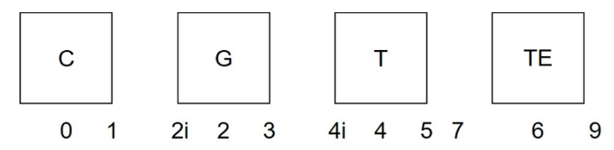
Questions
What does “most valuable” mean?
The position/alignment that:
Contributes the most for the least amount of money
To measure the value of each position, we will evaluate:
Several statistics (by position, and alignment) in defending the pass and run
Salary of top performers
For the purpose of this analysis:
Defending the pass and defending the run are considered equally important
Each in-game scenario carries equal weight
Coaching, and supporting casts are considered equal
LB will include OLB/”Edge rushers” only, DT will include NT
“Nature of the distribution of talent”
DE, DT, OLB across the following alignments, plus “outside” and “off ball”

Slide 4
The Analysis
Rushing the Passer
Sacks
Pressures
QB Strips
Stopping the Run
Tackles Short of First Down
TFL
Forced Fumbles vs running backs
EPA
Various in-game situations
Points will be awarded to position/alignment leaders, followed by a salary cap analysis to determine the most valuable position

Slide 5
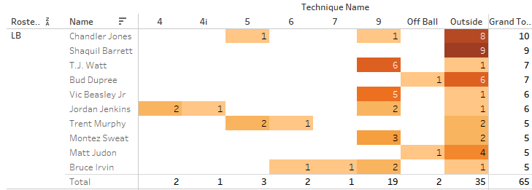
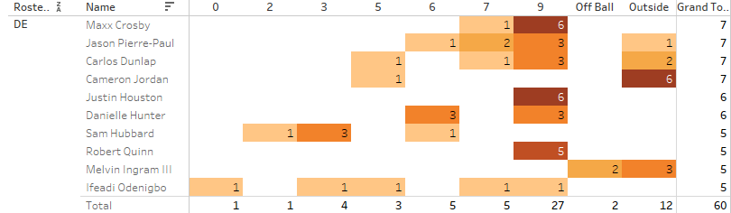
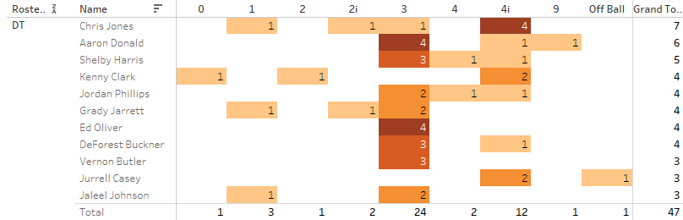
LB – 65 Sacks (38%):
Outside – 35 [54%]
9 tech – 19 [29%]
DE – 60 Sacks (35%):
9 tech – 27 [45%]
Outside – 12 [20%]
DT – 47 Sacks (27%):
3 tech – 24 [51%]
4i tech – 12 [26%]
Winner: LB – Outside: 35 Sacks
Notes:
Solo sacks only.
Sack distribution was fairly concentrated across all positions, with each group getting nearly half their production from one alignment
Linebackers and Defensive Ends produce the most sacks, 54% of total sacks came from the 9 and outside alignments
Winner: LB - Outside

Slide 6
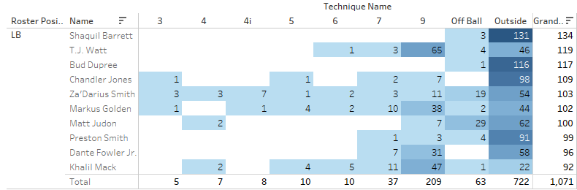
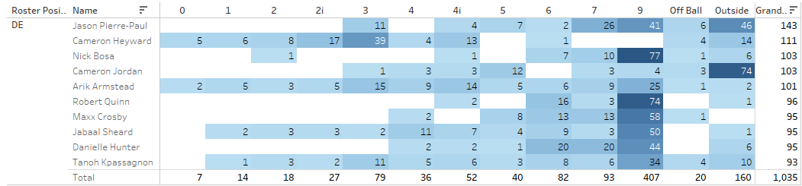
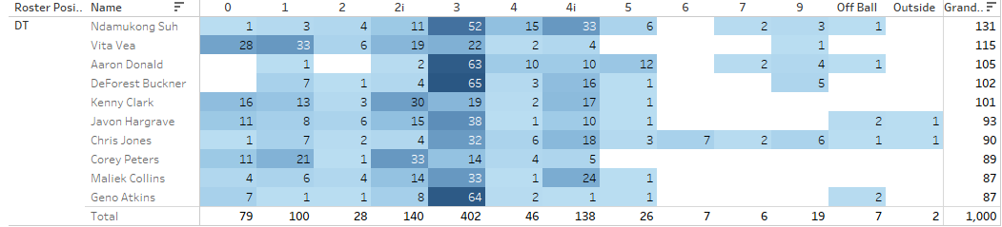
LB – 1,071 Pressures (35%):
Outside – 722 [67%]
9 tech – 209 [20%]
DE – 1,035 Pressures (33%):
9 tech – 407 [39%]
Outside – 160 [15%]
DT – 1,000 Pressures (32%):
3 tech – 402 [40%]
2i tech – 140 [14%]
Winner :LB – Outside: 722 Pressures
Notes:
Linebackers and Defensive Ends again leading in pressures. Defensive Ends with better distribution but Linebackers with the larger volume overall. 48% of sacks came from the 9 and outside, while 13% came from 3 tech defensive tackles alone
Winner: LB - Outside

Slide 7
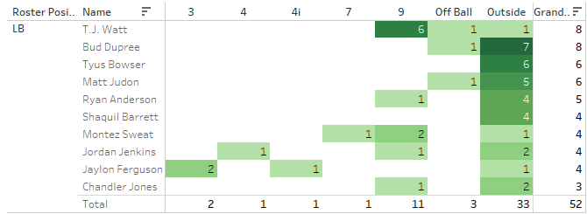
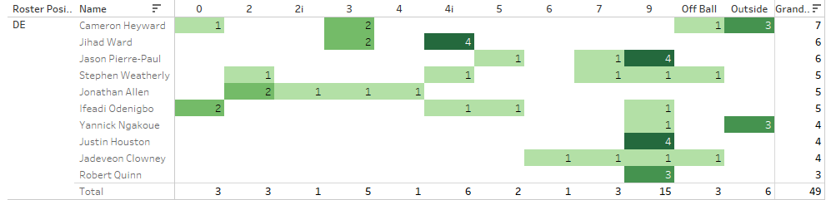
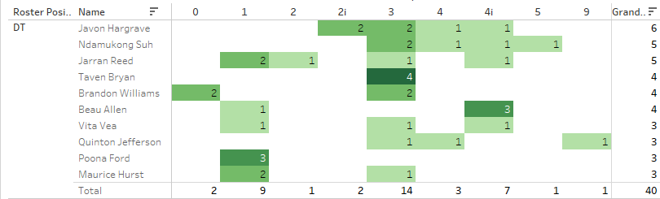
LB – 52 Forced Fumbles (37%):
Outside –33 [63%]
9 tech – 11 [21%]
DE – 49 Forced Fumbles (35%):
9 tech – 15 [31%]
4i/Outside – 6 [12%]
DT – 40 Forced Fumbles (28%):
3 tech – 14 [35%]
1 tech – 9 [23%]
Winner: LB – Outside: 33 Strip Sacks
Notes:
All early indicators are pointing to winning at the outside, 9, and 3 tech alignments to get to the quarterback
Winner: LB - Outside

Slide 8
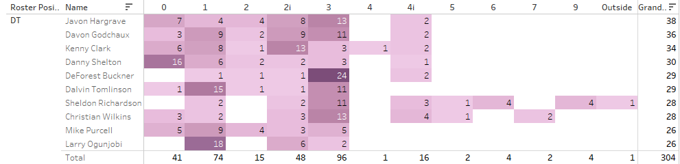
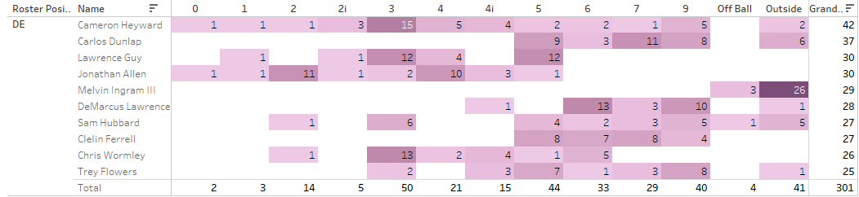
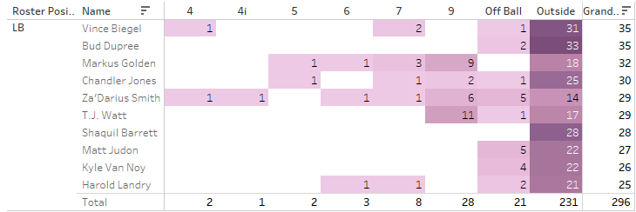
DT – 304 Tackles (34%):
3 tech – 96 [32%]
1 tech – 74 [24%]
DE – 301 Tackles (33%):
3 tech – 50 [17%]
5 tech – 44 [15%]
LB – 296 Tackles (33%):
Outside– 231 [78%]
9 tech – 28 [9%]
Winner: LB – Outside: 231 Tackles
Notes:
Defensive tackles recorded the most tackles short of 1st down. Nose tackles seem to contribute most here from the 0 and 1 alignments, with Defensive Tackles making their money from the 3-tech.
Outside aligned linebackers accounted for the greatest share of stops, with 26% of all stops from that alignment alone.
Winner: LB - Outside

Slide 9
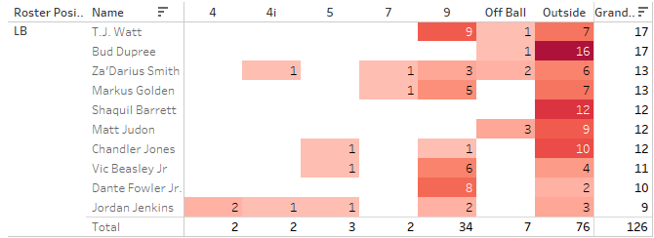
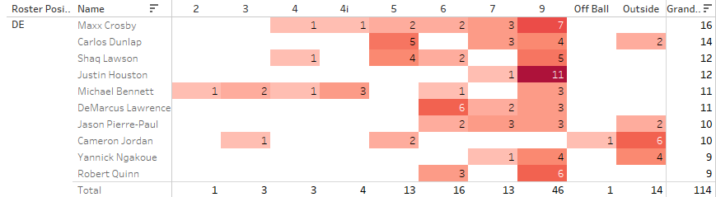
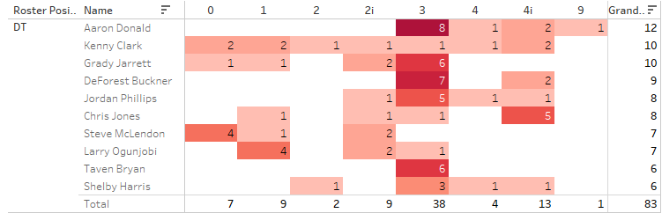
LB – 126 TFL (39%):
Outside – 76 [60%]
9 tech – 34 [27%]
DE – 114 TFL (35%):
9 tech – 46 [40%]
6 tech – 16 [14%]
DT – 83 TFL (26%):
3 tech – 38 [46%]
1 tech – 13 [16%]
Winner: LB – Outside: 76 TFL
Notes:
Linebackers on the outside are seemingly dominating so far. Defensive Tackles did the most damage from the 3 tech, Nose Tackles did not contribute nearly as much in TFL.
Defensive Ends are consistently producing from the 9 tech, but they aren’t nearly as productive from the 2-point stance.
Winner: LB - Outside

Slide 10
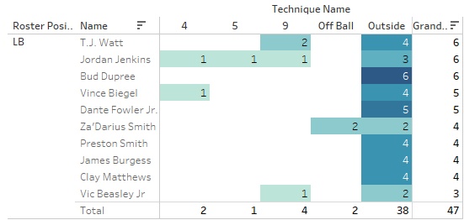
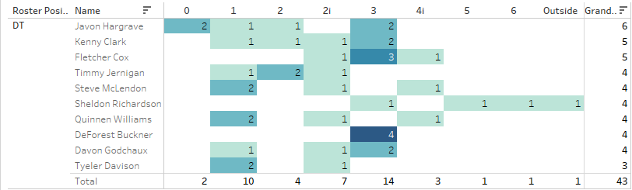
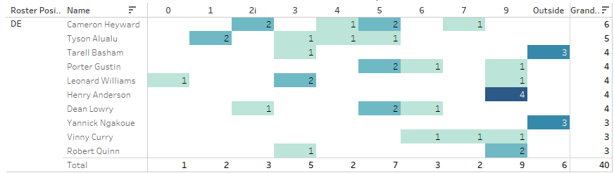
LB – 47 Forced Fumbles (36%):
Outside –38 [81%]
9 tech – 4 [9%]
DT – 43 Forced Fumbles (33%):
3 tech – 14 [33%]
1 tech – 10 [23%]
DE – 40 Forced Fumbles (31%):
9 tech – 9 [23%]
5 tech – 7 [18%]
Winner: LB – Outside: 38 FF
Notes:
Pretty evenly distributed here. Linebackers got a whopping 81% of their forced fumbles in the run from the outside alignment
Winner: LB - Outside

Slide 11
In-Game Situations
1st Down EPA
3rd Down EPA
4th Down EPA
Under 5 minutes EPA – 2nd Half
*only includes top performers from previous statistics

Slide 12
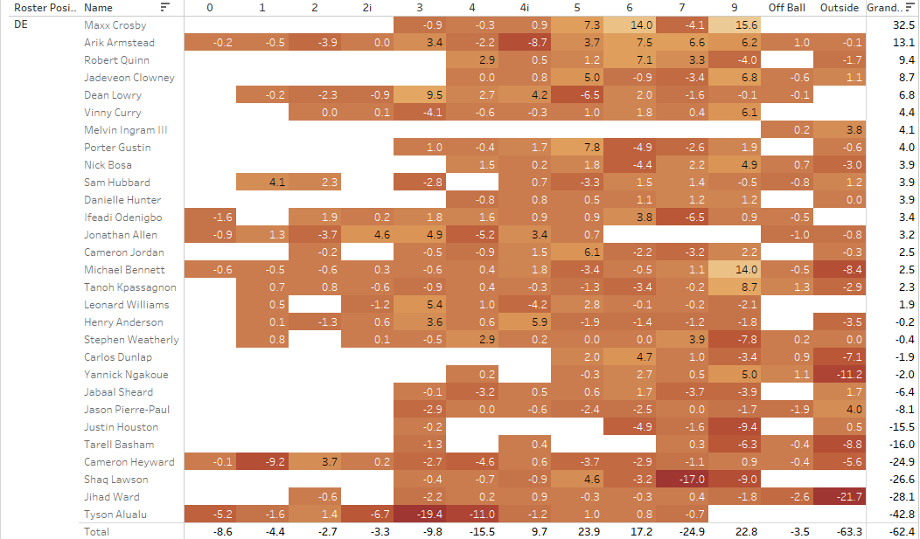
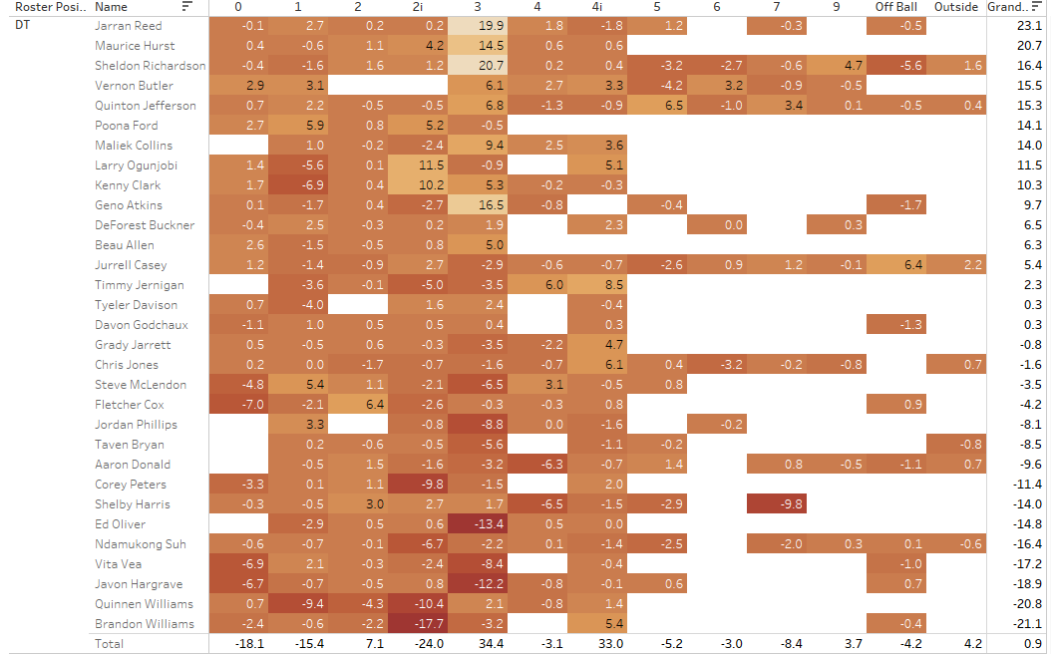
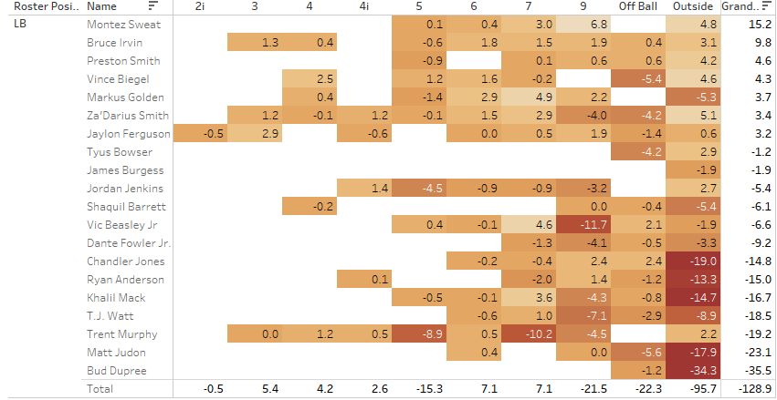
Notes:
Lots of data, go full screen to see better.
This is a sum of each players’ Expected Points Added on first down. I wanted to measure how effective each player was in getting the offense behind the sticks early.
Outside Defensive Ends contribute on a more consistent basis. The Outside LB group is skewed by a handful of extremely high performers. The same can be said for 3 tech Defensive Tackles.
Linebackers took the most points away in weeks 9-17 by more than twice as much as the Defensive Ends. The poorest performers in the Defensive Tackle group drag the rest of the group down.

Slide 13

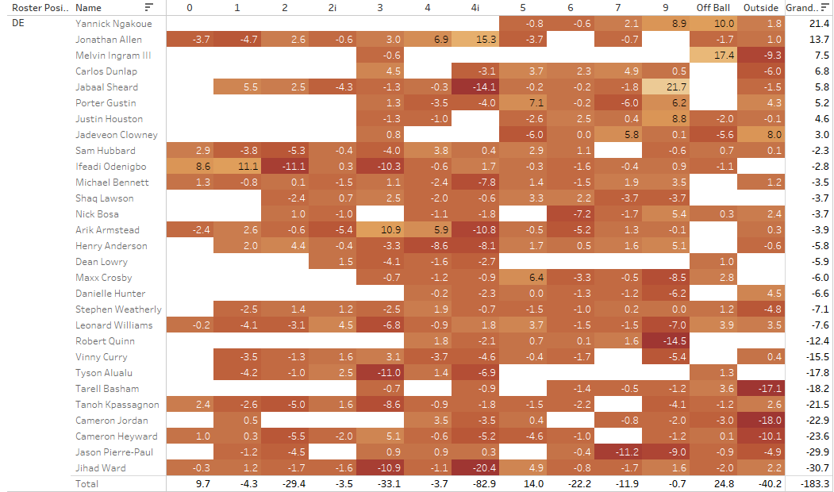
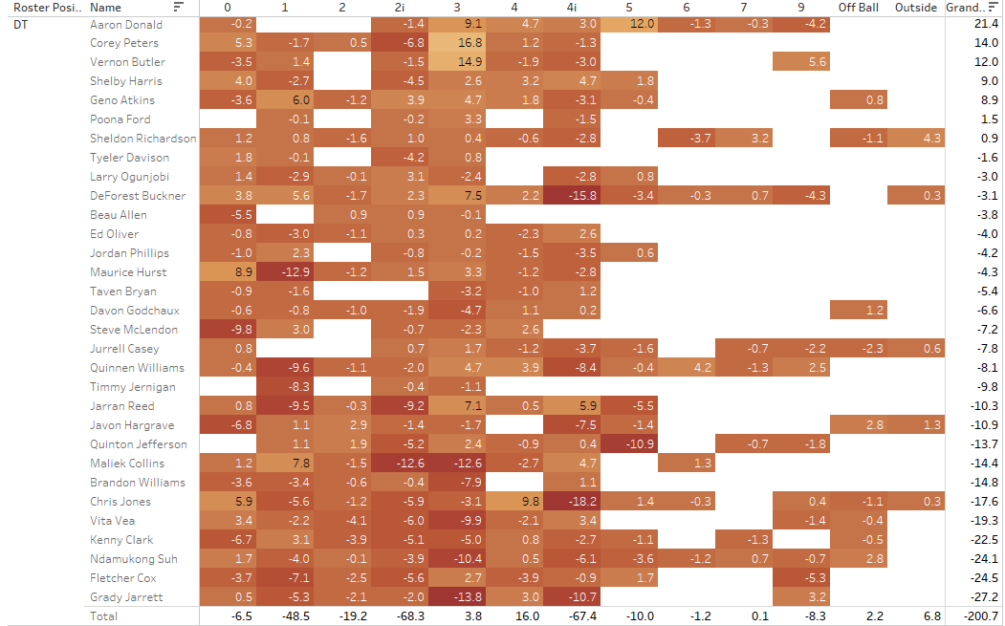
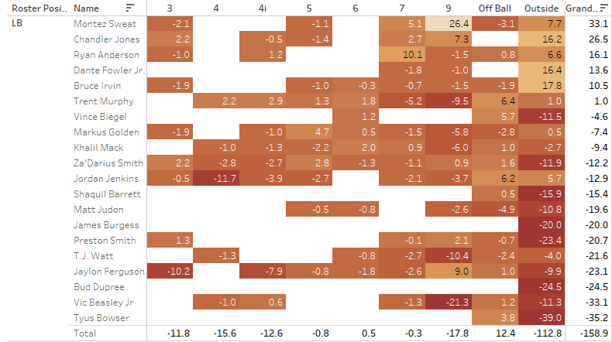
Notes:
Sum of Players’ EPA on 3rd downs. Teams win when they can get off the field on 3rd down.
Defensive ends dominated on 3rd down in terms of EPA from seemingly everywhere
Nose Tackle alignments thrived on 3rd down as well.
Linebackers from the outside have consistently been at or near the top in each category.

Slide 14
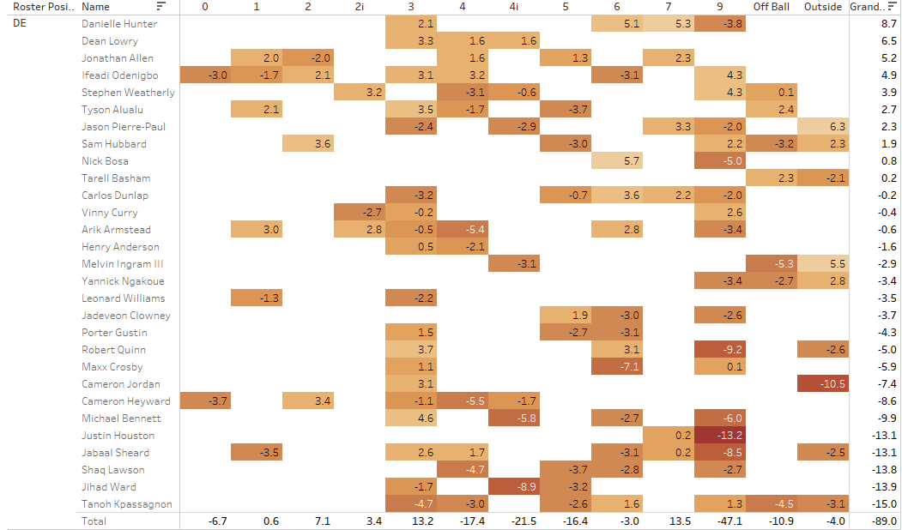
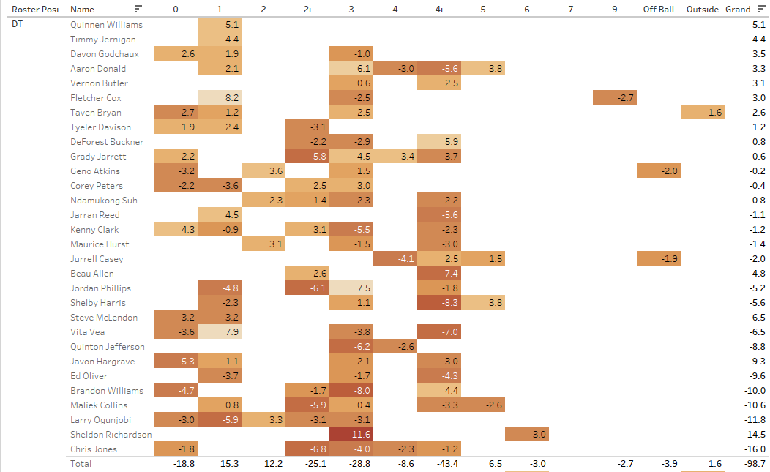
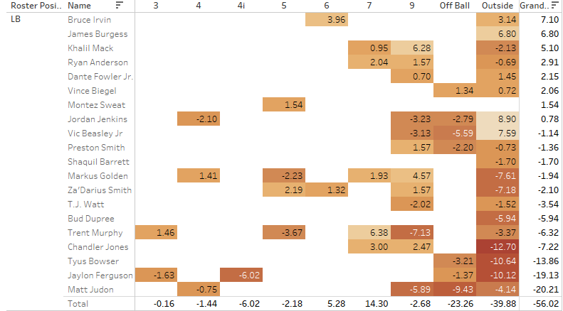
Notes:
4th down attempts are becoming more and more common in today’s NFL.
A team’s best chance to stop their opponent on 4th down will come from the edge yet again. The Lowest EPA came from Outside Linebackers, 9 tech Defensive Ends, and 3-tech Defensive Tackles.

Slide 15
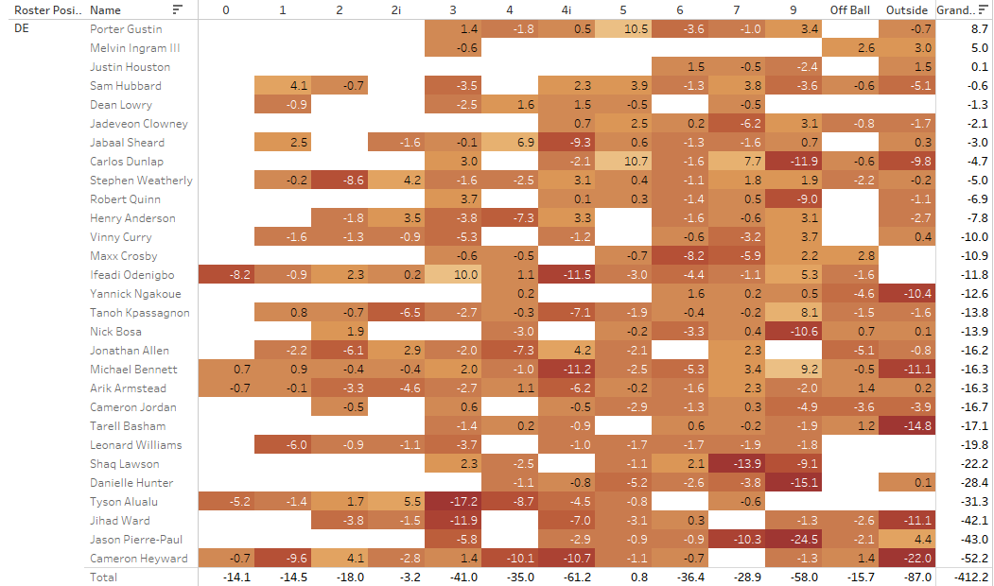
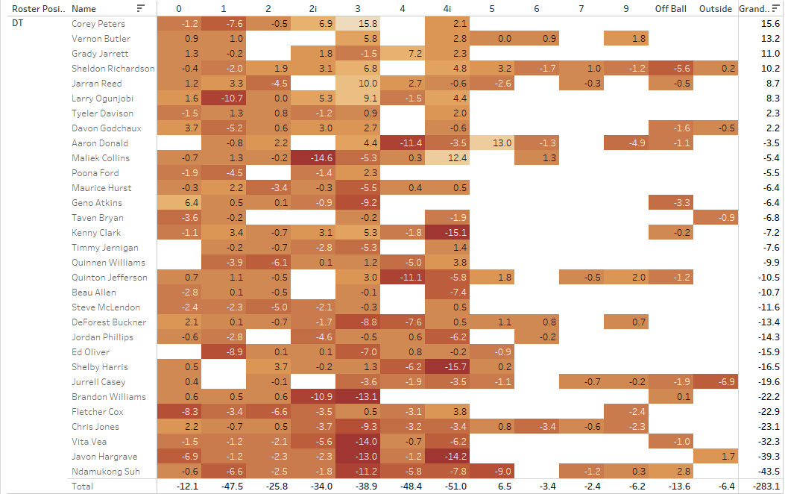
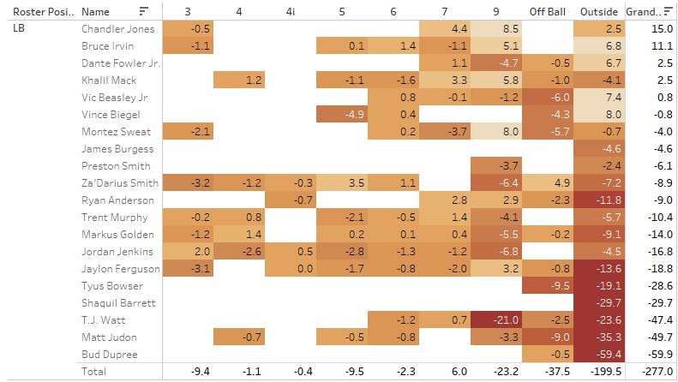
Notes:
I wanted to include EPA with 5 minutes or less left in the 2nd and 4th quarters. If you have a chance to win or get points before the half, you need a stop or get a turnover from your defense with 5 minutes or less to go.
Several high performers yet again from the Linebacker group.
Surprisingly, Defensive Ends from the outside alignment were unusually productive.

Slide 16
Salary Cap Analysis
Leaders so far:
LB – Outside
DE – 9 tech
DT – 3 tech
Salary Analysis (Spotrac)
2019 Salary
EPA vs salary
Salary vs position average

Slide 17
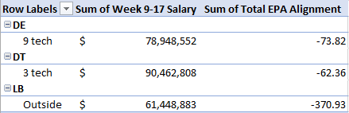
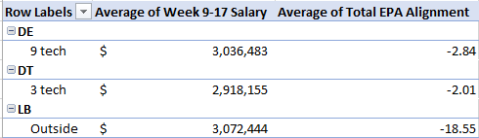

Notes:
Linebackers contribute the most, as proven by the statistical trends we saw earlier. They also earn the lowest EPA, or take the most points away from the offense. For the group of players we studied in this analysis, this group was the most productive AND the cheapest by nearly $17 million.
This group of Defensive Tackles saw production increase in different scenarios and in different measurements, but we never saw them lead the Linebackers or Defensive Ends in any of the categories measured. They are also the most expensive group with the highest total salary and least amount of points taken from the offense.
When we look at average salaries for the players involved, teams can pay less than $40,000 and get nearly a 6 fold return on EPA when comparing Linebackers in the Outside tech to Defensive Ends in the 9 tech. On average, the Linebackers are the most expensive group, but their production statistically (as we saw earlier) and in terms of EPA is undeniably greater, and well worth the investment.
Of all the positions and alignments we reviewed, I believe these are the 3 most valuable and most productive position-alignment combinations. When compared to each other, the outside tech linebacker can contribute to all facets of your defense for the least amount of money. If you can draft an edge player and get him to play at a high level early in his career, this will go a long way in allowing you to spend money on other positions of need.

Slide 18
Conclusion
Which is the most valuable defensive line position?
Outside Linebackers – outside alignment
What is the nature of the distribution of talent between the defensive line positions, as you define them?
Outside Linebackers contribute in the run and pass from outside alignment and 9 tech, Defensive Ends mainly contribute from the 9-tech, and Defensive Tackles contribute from the 3 tech and shaded over the center, depending on the situation.
Not all situations are created equal. In which in-game or roster construction scenarios would the answer to Question 1 change?
Game-wrecking DTs and DEs are more effective in late-game situations and on 3rd downs.

